Slide 1
What is communication?
The word ‘communicate’ comes from the Latin verb ‘communicare’ that means to impart, to participate, to share or to make common.
It is also the source of the English word ‘common.’ Whatever is common, it is shared by all. In communication, we share ‘information’. Through this process, we convey thoughts or feelings to someone else.
How it is received depends on a set of events and the stimuli that person is exposed to (context).
How you say and what you say plays an important role in communication

Slide 2
What is Business Communication?
A Quick Introduction

Slide 3
Think about it!
Why do employers want employees with good communication skills?
What are some of the communication skills that are a must have for a successful professional career?

Slide 4
How much do you agree with these statements?
Communication helps build effective relationships with colleagues and business partners.
It helps you become a better team player, contribute more to innovative projects, influence decisions, and get your ideas and proposals accepted.
It helps employers improve and manage relationships with customers and resolve conflict.
Good communication helps to make the most of opportunities.

Slide 5
Benefits of effective communication practices
better quality of services and products
increased productivity
↑ more staff suggestions
↑ higher levels of creativity
↑ greater employee job satisfaction
↓ decreased absenteeism
↓ reduced staff turnover
↓ less industrial unrest and fewer strikes
↓ lower costs

Slide 6

So, What is Business Communication?

Slide 7
Some definitions!
Business communication is a process of transmitting information and thoughts between various parts of an organization and also to people outside the organization such as customers, investors, suppliers etc.
According to Mr. Brennan ‘Business Communication is the expression, channeling and interchanging of ideas in commerce and industry.’

Slide 8
A Simpler Definition!
Broadly speaking, business communication is defined as the written and spoken interaction that takes place between people who operate in business contexts.

Slide 9
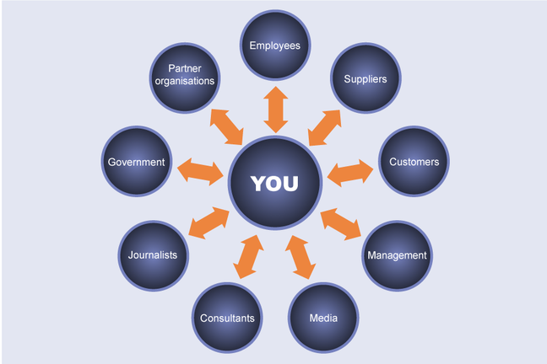
As an employee, what direction does your communication take?

Slide 10
There are different types of business communication you will encounter in your professional life.

Slide 11
Internal & External Business Communication
Internal communication takes place between people inside a company while external communication takes place between the company and outside parties.

Slide 12
Internal & External Business Communication
The internal communication could be either oral or written.
a) Oral methods of internal communication: It includes telephone messages, meetings, conferences, presentations, face-to-face communication, and etc.
b) The written methods of internal communication: it includes memos, reports, graphs, notices, forms, questionnaires, minutes, newsletters, and etc.

Slide 13
Internal & External Business Communication
External communication can also be either oral or written.
Oral forms of external communication.
It includes: meetings, conferences, conversations, telephone messages, presentations, and etc.
The written forms of external communication.
It includes: leaflets, brochures, press releases, advertisements, notices, reports, e-mails, faxes, letters and etc.
Ideas and information flow along the lines of command/the hierarchical levels.

Slide 14
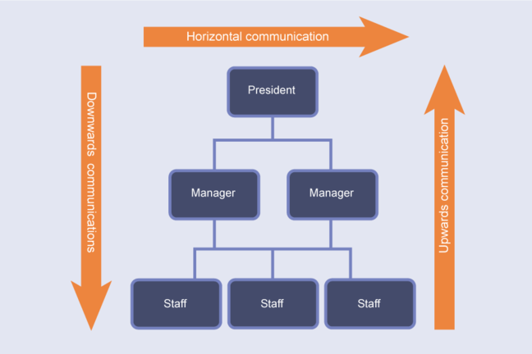
Throughout the internal formal network, information flows in three directions.

Slide 15
Formal Business Communication Network within the Organization
Downward Communication-Flows from executives to employees conveying executive decisions and providing information that helps employees do their jobs.
  Upward Communication-flows from employees to executives, providing insight into problems, trends, opportunities, grievances, and performance-thus, allowing executives to solve problems and make intelligent decisions.

Slide 16
Formal Business Communication Network within the Organization
  Horizontal Communication-Flows between departments to help employees share information, coordinate tasks, and solve complex problems.

Slide 17
Quiz! Which of the following explains upward, downward, & horizontal communication?
The flow of communication such that management provides information, gives instructions, asks for feedback and generally supports and motivates employees.
It occurs such that employees provide feedback and information, report on their activities and request support.
Finally, it flows horizontally across the organisation to facilitate exchanges of information and support between departments in the coordination of work carried out by interdepartmental teams.

Slide 18
So, we talked about what business communication and its types.
Now, let us discuss the whole and sole objectives/goals of business communication???

Slide 19
Goals of Business Communication
Receiver Understanding-The message must be so clear that the receiver understands it as the sender means it to be understood.
Receiver Response-Business Communication is goal oriented and the objective is to achieve a certain response from the receiver.
Favourable Relationship-A strong business relationship has to be established.
Organizational Goodwill-The organization needs the goodwill of its employees, customers, and clients.

Slide 20
What can happen if you fail in even one of these goals???

Slide 21
Failure at communication is unaffordable for an organization.
Assignment: Find one example of an organization that failed at business communication and the consequences it henceforth faced.

Slide 22
Let’s Discuss how to achieve these goals
Receiver Understanding:
To develop a clear message, the sender must consider the following four issues:
  Receiver`s characteristics
  Message form and content
  Receiver`s feedback
  Communication barriers
  7 Cs Needed: Completeness, Concreteness, and Concisness

Slide 23
Let’s Discuss how to achieve these goals
2. Receiver Response:
The sender should assist the receiver to respond.
Senders respond through words, actions, or both.
7 Cs Needed: Completeness, Concreteness, and Conciseness

Slide 24
Let’s Discuss how to achieve these goals
3. Favorable Relationship:
To establish a strong business relationship, the sender and receiver must relate to each other in 3 important ways: positively, personally, and professionally.
The sender must assume responsibility for creating and maintaining favorable relationships in 3 ways:
  Stressing the receiver’s interests and benefits
  Using positive wording
  Doing more than what is expected
  7 Cs Needed: Consideration and Courtesy

Slide 25
Let’s Discuss how to achieve these goals
4. Organizational Goodwill:
Message senders have the responsibility to try to increase goodwill for their organization. They do so by reflecting positively on the quality of the company’s products, services, and personnel.
  7 Cs Needed: Consideration, Correctness, and Courtesy

Slide 26
Formal and Informal Business Communication
Formal Business Communication:
Formal communication is business related. It can be written (memo, report, policy) or oral (speech, meeting).
Most organizations keep written records of formal communication-copies of speeches, minutes of meetings.
Formal communication is planned, flows in all directions, and is essential for the effective operation of the business.

Slide 27
Formal and Informal Business Communication
Informal Business Communication:
Grapevine is an informal communication, unorganized and unofficial channel of communication in an organization.
The grapevine is used to spread information bypassing the formal communication structure. Just like the grapevine plant: it spreads in random ways and it goes where it can.
The grapevine is formed by individuals and groups in an organization. The people in the groups have something in common that links them together.
It includes gossips and rumours.

Slide 28
How can we make use of grapevine to our advantage as a business communicator without being unethical???

Slide 29
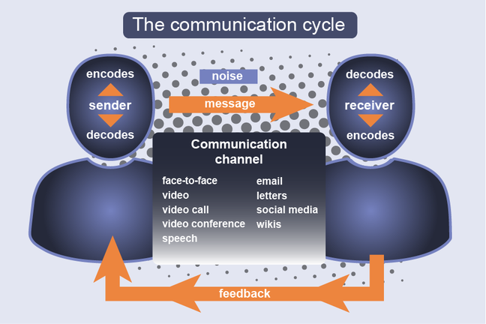
Interpreting business communication using the communication model

Slide 30
Interpreting business communication using the communication model
The understanding of the communication process will strengthen your performance as a communicator.
Business communication process has the same elements as the general communication process. For example:
Sender, Receiver, Message, Feedback, Context, Barriers

Slide 31
Understanding the business context
Each organization has its own culture, a personality that affects the communication environment. Leaders, traditions, attitudes, and philosophies determine each organization’s culture.
Some organizations are formal-conservative clothing, limited access to leaders, and a preference for written communication.
Others are informal-casual dressing, open door policies, and a preference for oral communication.

Slide 32
Understanding the business context
Other factors influencing the culture are the organization’s values relating to diversity, seniority, teamwork, individuality, and ethics.
An organization’s culture can be dynamic, changing with its size and leadership.
Effective communicators adapt to and positively influence the development of their organizational culture.

Slide 33
Sender and Receiver Roles in Business Communication
Sender | Receiver
Selecting the type of message | Listening or reading carefully
Analyzing the receiver | Being open to different types of senders and to new ideas
Using the you-viewpoint | Making notes when necessary
Encouraging feedback | Providing appropriate feedback to the sender
Removing communication barriers | Asking questions to clarify the message

Slide 34
Channel Selection
Verbal | Non-Verbal
Written: Memos, letters, emails, web pages, notes, reports, telegrams, newsletters, news release | Human-channel: Gestures and facial expressions
Oral: Face to face conversation, telephone conversation, voice mail, in-person conference, video conference, presentations, speeches | Object-based non-verbal messages: Appearance and layout of document, the audio and visual clarity of a video-taped presentation

Slide 35
Encoding of Business Communication, it`s features and style.
Use 7 Cs
Clarity
Completeness
Correctness
Conciseness
Concreteness
Consideration
Courtesy

Slide 36
Ethical business communication
Professional business communicators behave ethically when they:
follow the organisation’s policies, procedures, guidelines and code of ethics
communicate factual information objectively
avoid using distortions of fact and misleading information
respect the dignity of each person, irrespective of ethnic background, religion or gender.

